Slide 1
Lebron’s Scoring
Pratik Banala
https://github.com/pratikbanala/Lebron

Slide 2
Background
Lebron James is an NBA player who currently plays for the Los Angeles Lakers. He is widely considered to be one of, if not the greatest players of all time.
He is currently in his 19th season in the league and is still one of the best players today.
The Lakers are in a slump right now, and have been losing way more than expected, due to Lebron essentially being the only good and experienced player on his team.
He is currently in the race for the season scoring title because he is being forced to score a majority of the team’s points in an effort to win.

Slide 3
Objective
The objective of my project is to identify a model that can accurately predict how many points Lebron will score.
The data I will be focusing on is Lebron’s personal statistics as well as his opponent’s game statistics.
I will be scraping team data from NBA and Lebron’s data from Basketball Reference.
If successful, I plan on using this model in a subsequent project that will predict Lebron’s scoring in upcoming games.

Slide 4
Pseudocode
Scrape team statistics for all teams that have played against the Lakers this season
Scrape Lebron’s season statistics
Clean data and combine into a workable dataframe using Pandas
Test correlation between variables.
If possible, find a working model from SKLearn’s in-built regression models.

Slide 5
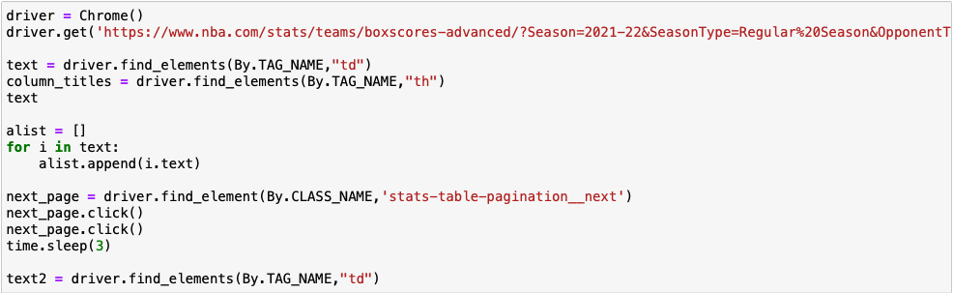
Web Scraping
I used Selenium to retrieve the team data from the official NBA website.
I gathered all team statistics using the “td” tag, as well as the column headers using “th”.
The data was split between two pages, so I had to initialize a variable that would isolate the “Next Page” element and click it, and then scrape the remaining data.
For Lebron’s individual stats, I went to basketballreference.com, a database that holds all NBA-related data throughout its entire history.
The website offers the option to export data as a CSV file, so I opted for that instead of scraping.

Slide 6
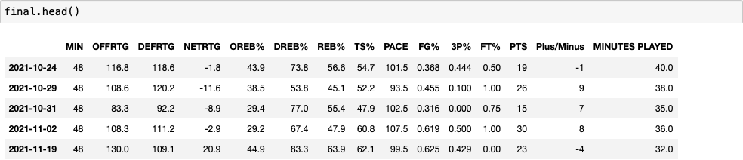
Data Cleaning
The scraped data was fed into a dataframe called “final”, and all columns were converted to float, except for the date which was converted to datetime and set as the index.
I imported the downloaded data from Basketball Reference as a csv file and read it into a dataframe called “Lebron”.
“Lebron” had a column “MP” which was the minutes played by Lebron in each game, formatted as such: 00:00:00.
I converted this to the “MINUTES PLAYED” column (seen above) using a for-loop that extracted the first two digits as “minutes”, unless the seconds value was 30 or higher, in which case the first two digits + 1 was returned.
The dataset was combined and games where Lebron did not play were filtered out.

Slide 7
Variables
Lebron’s points is what I am trying to predict, so that was set to the dependent variable.
The independent variables I decided to utilize were the opposing team’s DEFRTG, DREB%, and Lebron’s minutes played.
DEFRTG is a measure of the team’s defensive performance.
(Allowed Points / Opponent’s Possessions) * 100
This formula returns the number of points a team would allow if the opposing team had possession of the ball 100 times.
Lower = better
DREB% is the percentage of available defensive rebounds that were obtained by the team.
Minutes Played is the number of minutes that Lebron James was on the court.

Slide 8
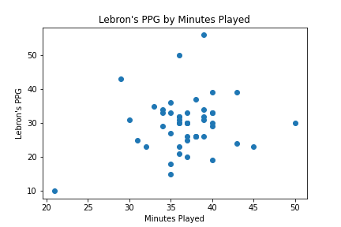
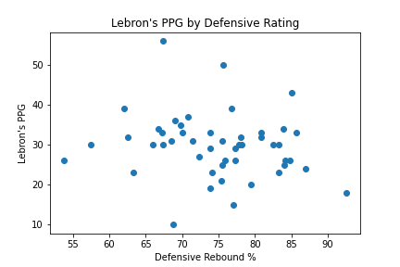


Slide 9
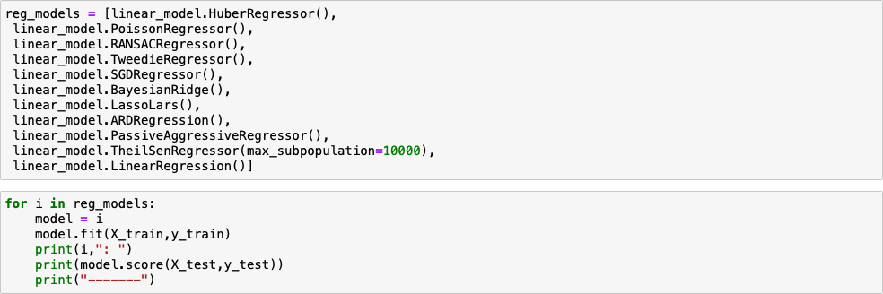
Modeling
For modeling the data, I compiled a list of all the regression models in the SKLearn Linear Model library, using dir(linear_model).
I also used train_test_split to separate the data using a train-test ratio of 80%/20%.
I then ran a for-loop that went through each model, fit the X_train and y_train values to each model, and printed the model’s name and its score.

Slide 10
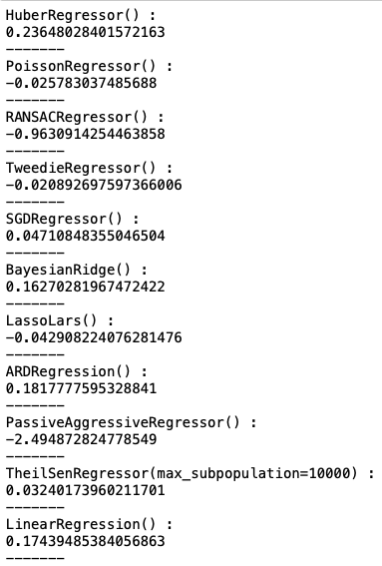
Results
The results were frankly disappointing overall, but the RANSAC regressor did show a high correlation.
RANSAC is an acronym for Random Sample Consensus.
This algorithm fits a regression model on a subset of data that is judged as inliers while removing data considered to be outliers. This process strengthens the fit of the model by removing data points that may skew the fit.
This method identifies a strong negative correlation between the independent and dependent variables.

Slide 11
Potential Errors/Model Confusion
The independent variables that I used do not affect the dependent variable in the same fashion.
Better DEFRTG and DREB% would logically translate to a lower score for Lebron, but more minutes played would logically translate to a higher score for Lebron.
It makes sense that Lebron, given more minutes, would score more points.
He may have diminishing returns due to exertion and changes in defensive game-plan, but overall the points should increase.
I believe this may have inadvertently confused the models, and this is why the scores as a whole were so low.

Slide 12
Interpretation
The RANSAC regressor returned a high negative correlation, which is logical for certain parts of the data.
It is to be expected that as a team’s DEFRTG gets better, Lebron will score less points.
Additionally, a team that rebounds better on defense is grabbing rebounds that could potentially go to Lebron and lead to a score.
The negative correlation does not realistically make sense for the minutes-played variable; as mentioned earlier, giving a player more time would likely increase their point total.
Perhaps the RANSAC method was able to identify a larger impact from the defensive statistics than from Lebron’s minutes played.

Slide 13
Conclusion
While the RANSAC regressor found some success, I believe that fixing the variables would have led to better scores across more or even all of the regressors.
Perhaps picking variables that affect Lebron’s scoring similarly would have led to less confusion and thus higher success.
I will rerun the data with better variables (e.g.: replacing minutes played with opponent’s DFG%), and I expect the corresponding results to be more robust and logical.

Slide 14
Sources
Art’s brain
NBA Advanced Stats
2021-22 season, games played against Los Angeles Lakers
https://www.nba.com/stats/teams/boxscores-advanced/?Season=2021-22&SeasonType=Regular%20Season&OpponentTeamID=1610612747
Basketball Reference
2021-22 season, Lebron James Game Log
https://www.basketball-reference.com/players/j/jamesle01/gamelog/2022

